Slide 1
AIML CA1
DAAA/FT/2A/05
Koh Hui Lyn
(P2021672)

Slide 2
TABLE OF CONTENTS
01
02
CLASSIFICATION
Highlights of Mushroom Classification Dataset Jupyter notebook
REGRESSION
Highlights of Housing Regression Dataset Jupyter notebook

Slide 3
01
CLASSIFICATION
Classifying whether Mushrooms are Edible or Poisonous

Slide 4
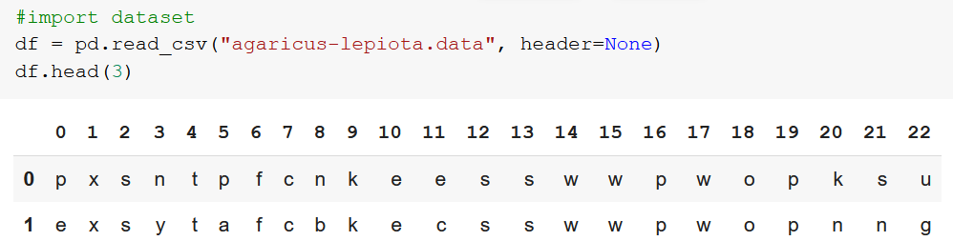
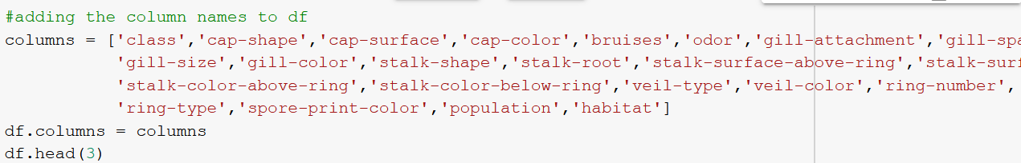
CLASSIFICATION – DATA PREPROCESSING

Slide 5

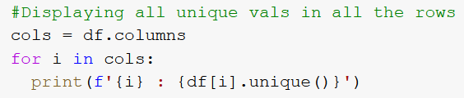
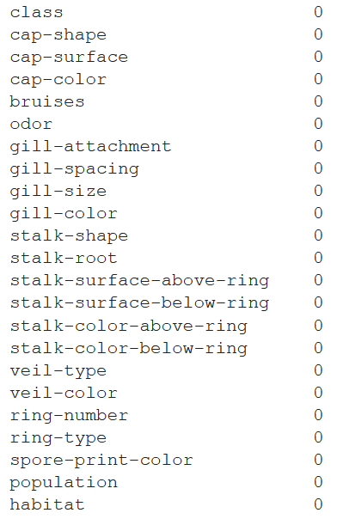
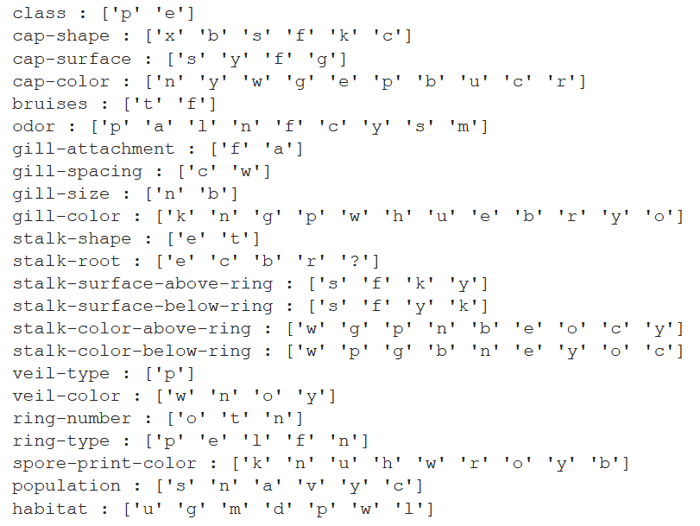
CLASSIFICATION – DATA PREPROCESSING

Slide 6

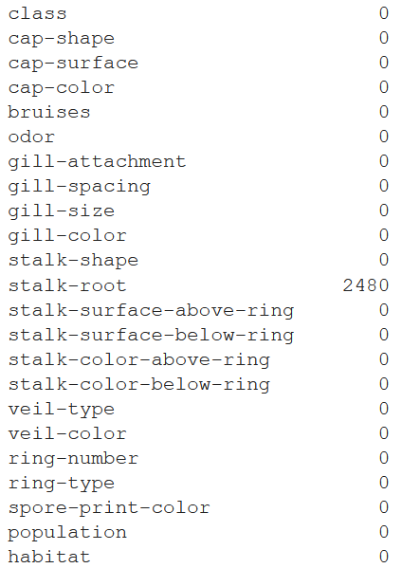
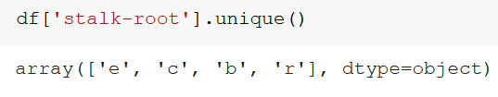
CLASSIFICATION – DATA PREPROCESSING

Slide 7
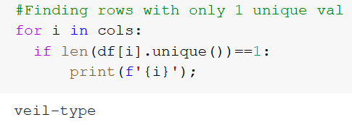
CLASSIFICATION – DATA PREPROCESSING

Slide 8

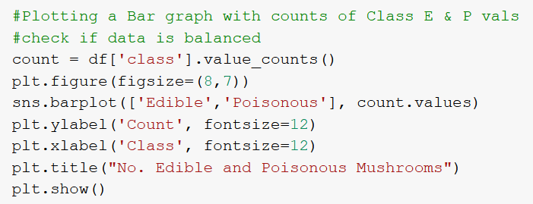
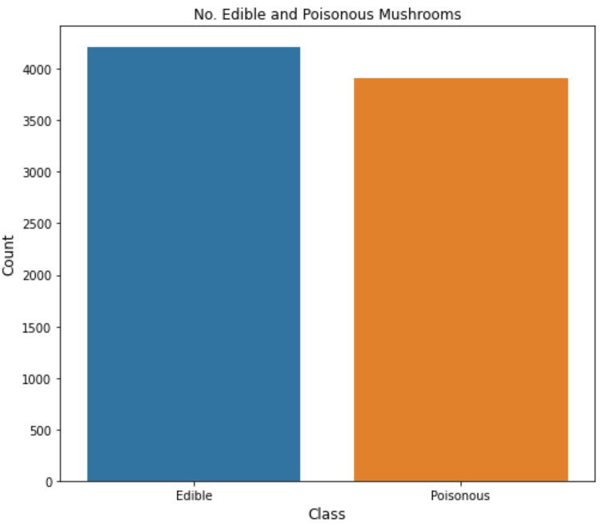
CLASSIFICATION – DATA PREPROCESSING
To be predicted:

Slide 9
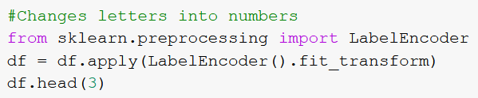
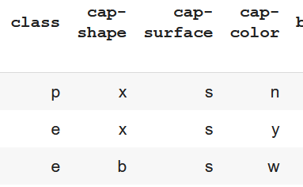
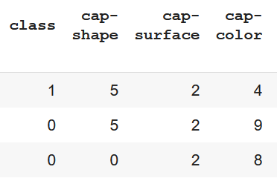
CLASSIFICATION – DATA PREPROCESSING

Slide 10
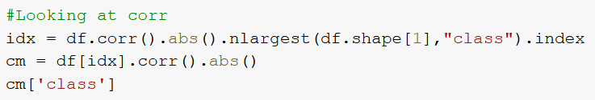
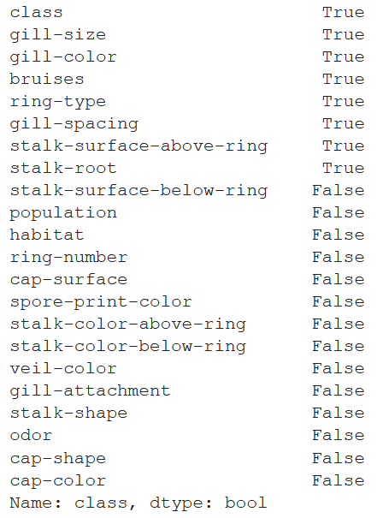
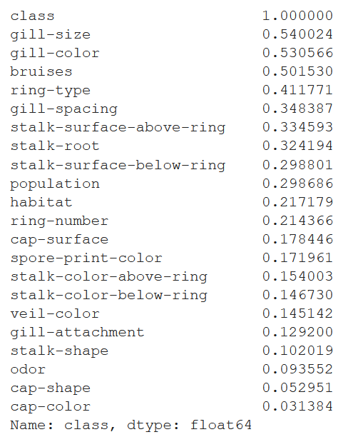

CLASSIFICATION – DATA PREPROCESSING
As I have too many columns, I decided to remove those with poor correlation to class

Slide 11
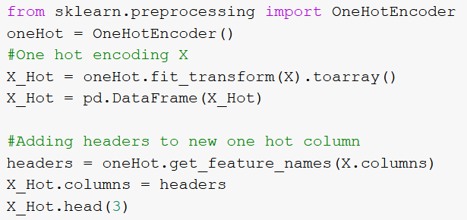
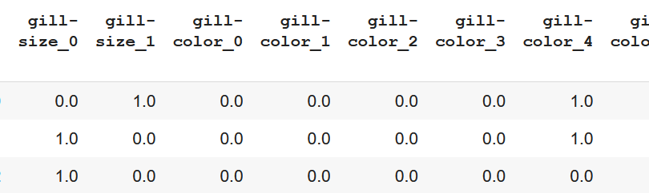
CLASSIFICATION – DATA PREPROCESSING

Slide 12
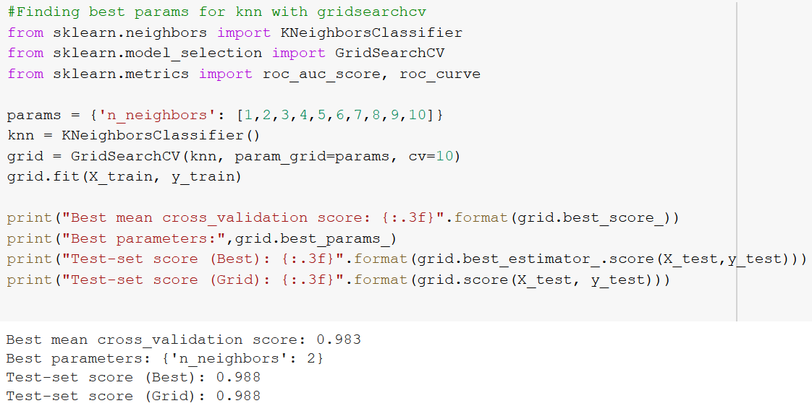
CLASSIFICATION – KNN
Using GridSearchCV to find the best params for the model

Slide 13
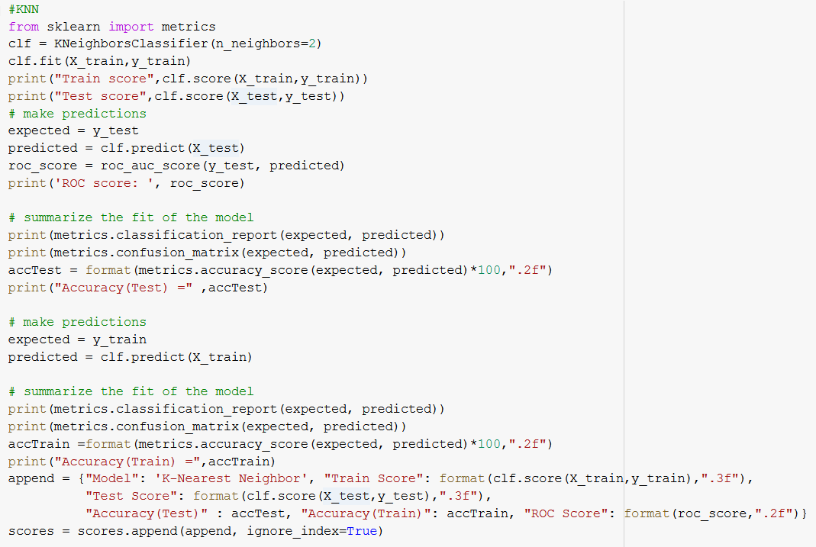

CLASSIFICATION – KNN
Introduce and fit the model, set the params to the best params from the GridSearchCV
I predicted values with the test set, and also produced the ROC Score.

Slide 14
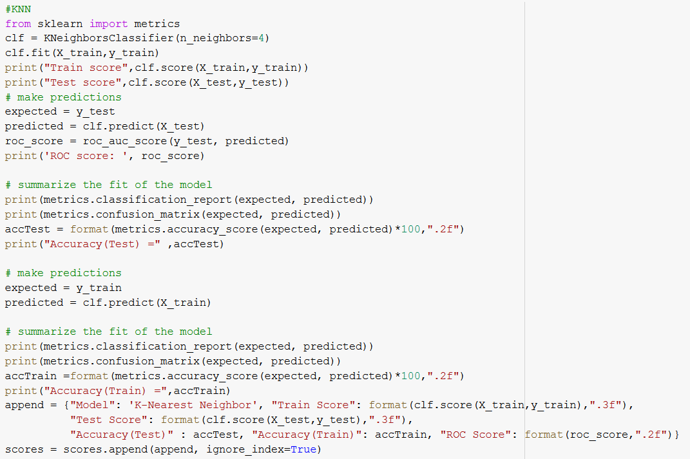
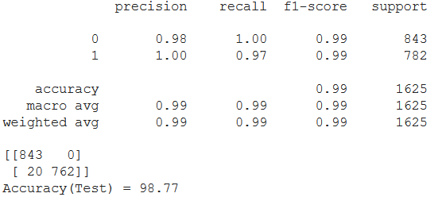
CLASSIFICATION – KNN
I summarised the Test set

Slide 15
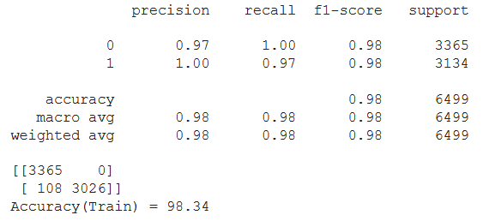
CLASSIFICATION – KNN
I predicted with the train set
And summarised the train set

Slide 16
CLASSIFICATION – KNN

Slide 17
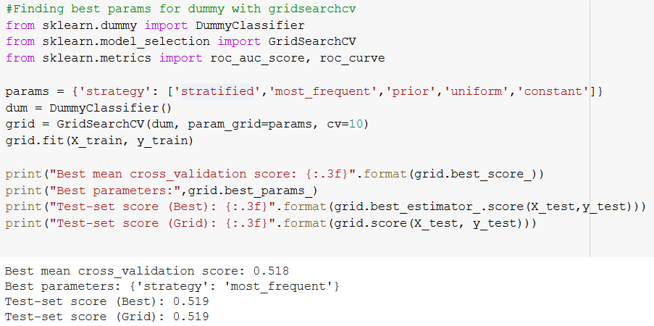
CLASSIFICATION – DUMMY

Slide 18
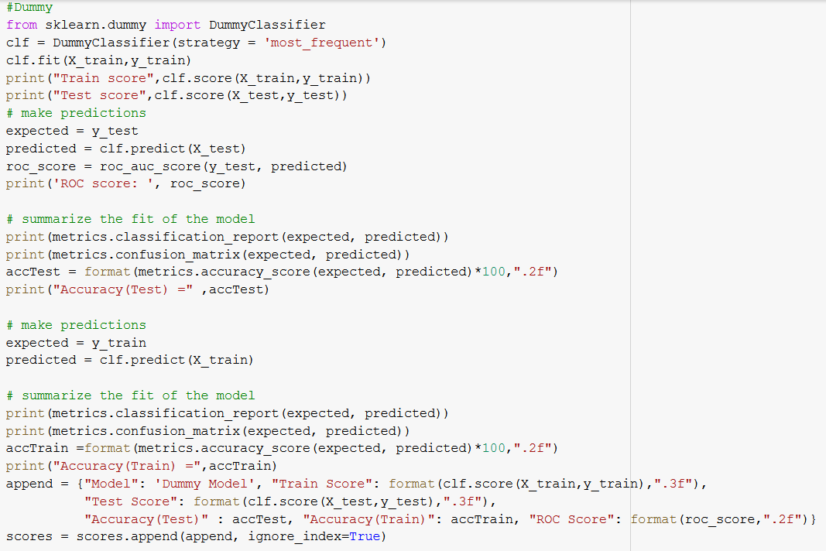
CLASSIFICATION – DUMMY

Slide 19
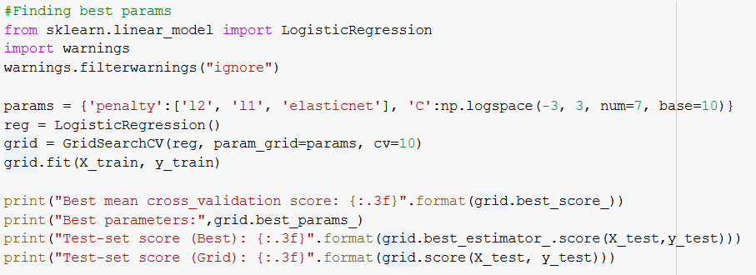

CLASSIFICATION – LOGREG

Slide 20
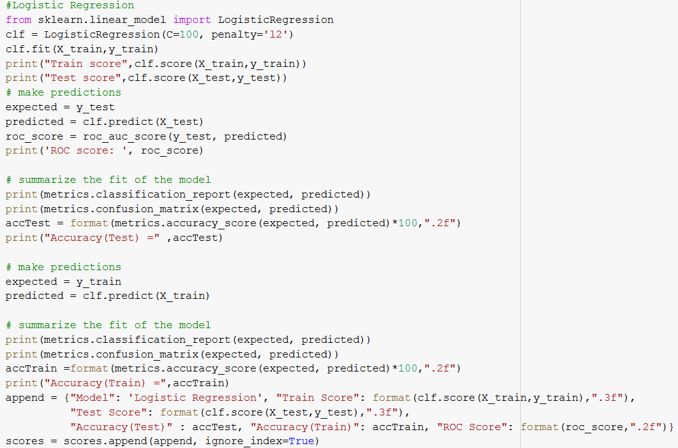
CLASSIFICATION - LOGREG

Slide 21
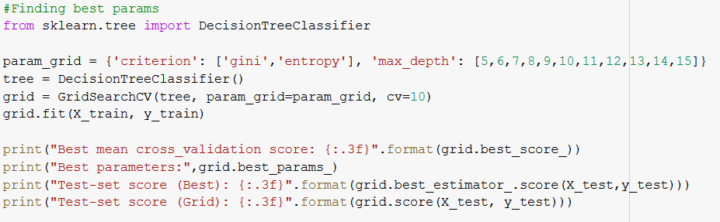

CLASSIFICATION – DECISION TREE

Slide 22
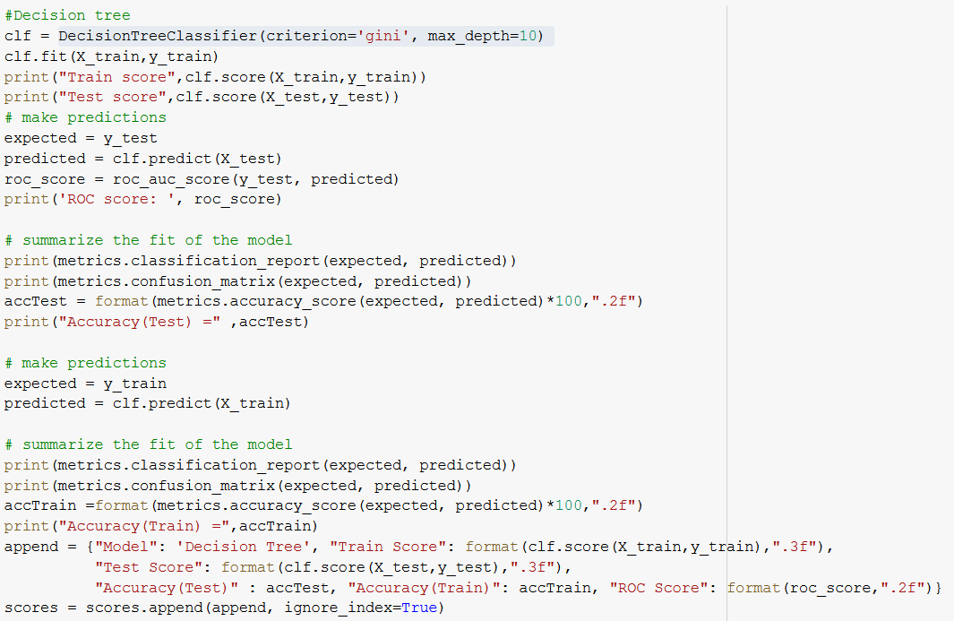
CLASSIFICATION – DECISION TREE

Slide 23
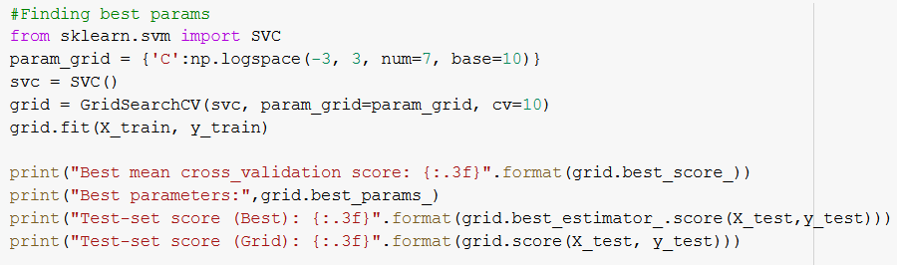

CLASSIFICATION – SVC

Slide 24
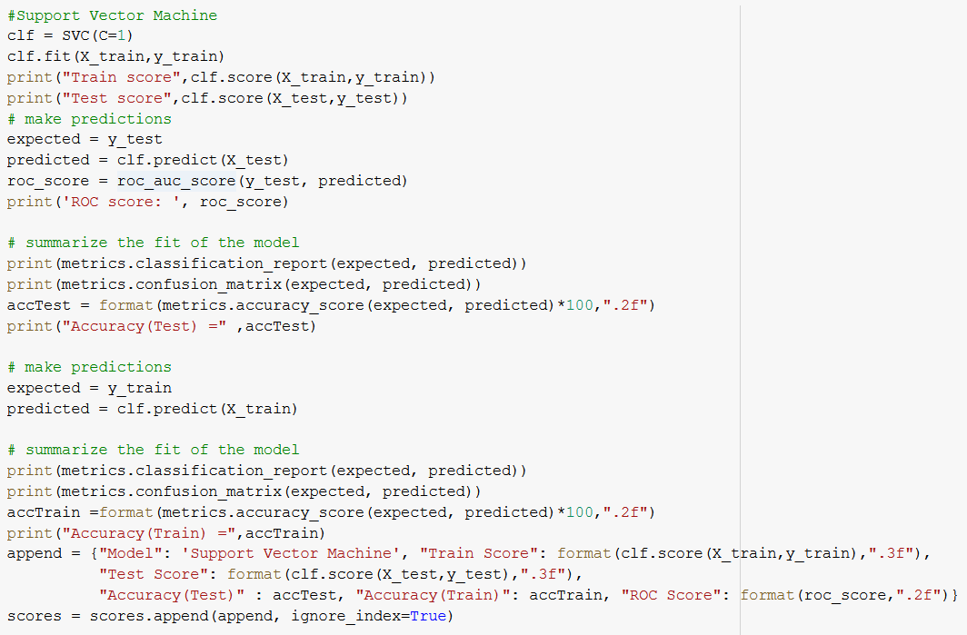
CLASSIFICATION – SVC

Slide 25
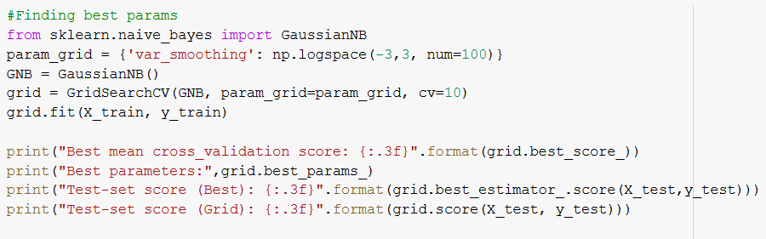

CLASSIFICATION – GAUSSIAN

Slide 26
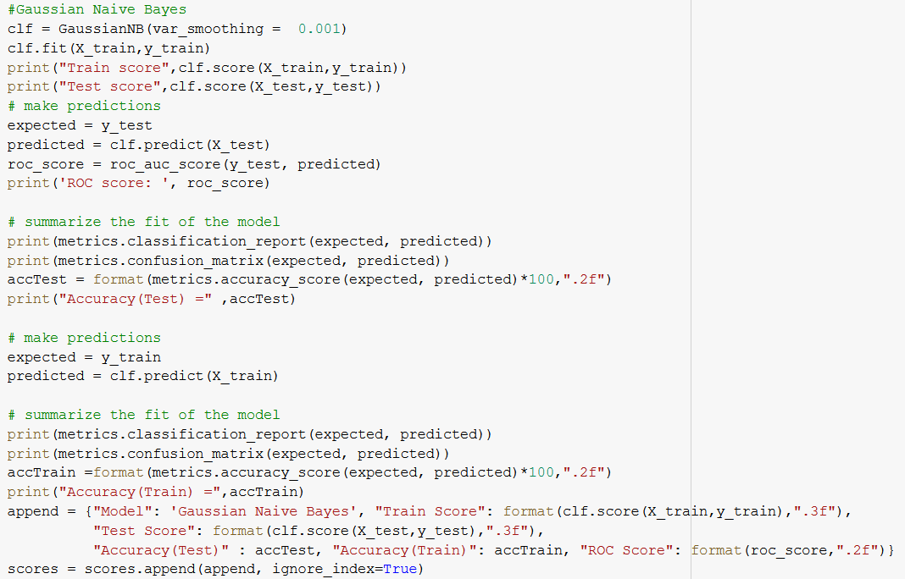
CLASSIFICATION – GAUSSIAN

Slide 27
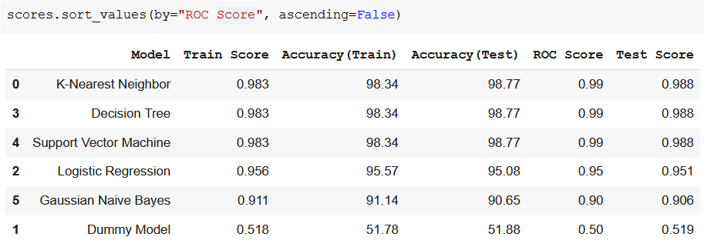
CLASSIFICATION – RESULTS
Simple Baseline Model
Dummy model

Slide 28
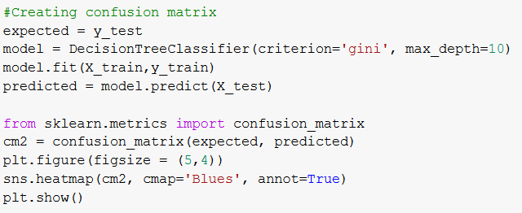
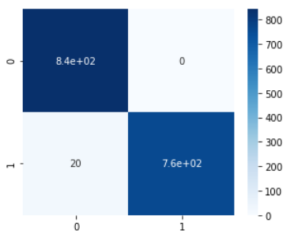
CLASSIFICATION – RESULTS
Decided to choose DecisionTreeClassifier
Along the diagonals, predicted correctly
(840)
Edible Mush
(760)
Poison Mush
2% chance

Slide 29
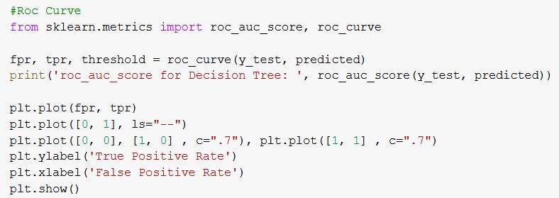
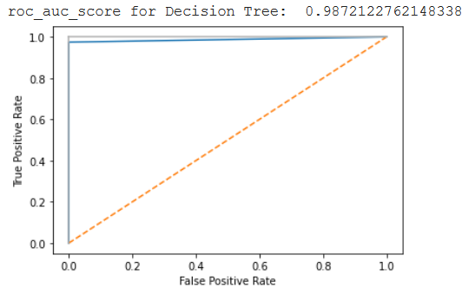
CLASSIFICATION – RESULTS
ROC score close to 1, but not 1
-> not overfitted
->mostly accurate

Slide 30
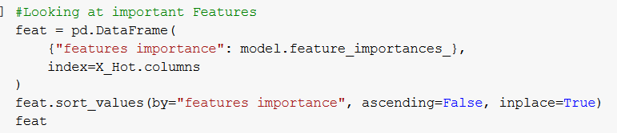
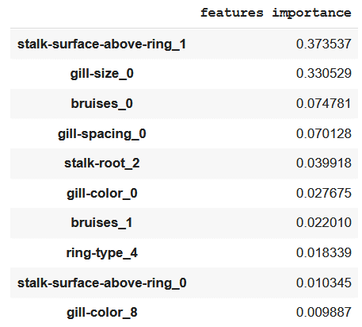
CLASSIFICATION – RESULTS
Top 10 features →
The best 3:
Stalk-surface-above-ring = k (silky)
Gill-size = b (broad)
Bruises = f (no bruises)

Slide 31
02
REGRESSION
Predicting House prices in King County

Slide 32

REGRESSION - PREPROCESSING
I didn’t need
Correlated to sqft_lot15
Correlated to sqft_lot

Slide 33

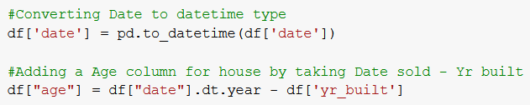
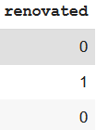

REGRESSION - PREPROCESSING
Used columns to make new columns

Slide 34
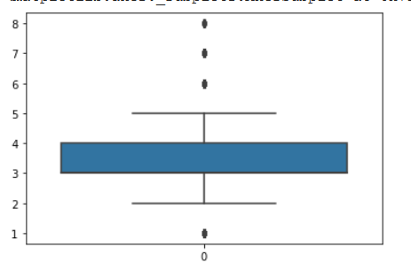
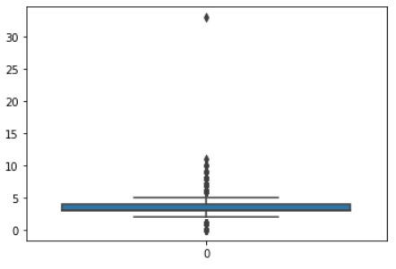
REGRESSION - PREPROCESSING
???

Slide 35
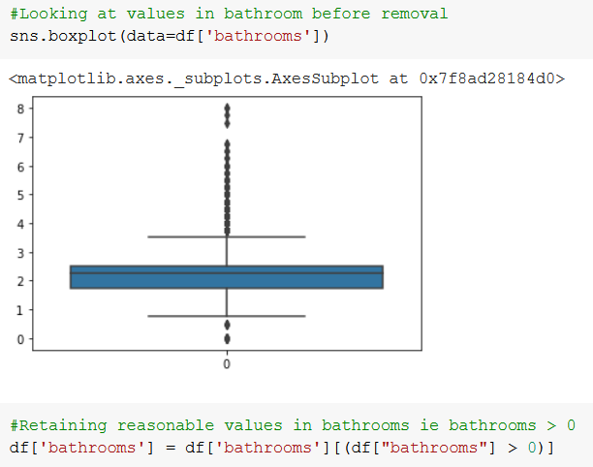
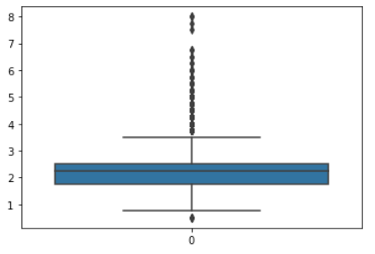
REGRESSION - PREPROCESSING

Slide 36
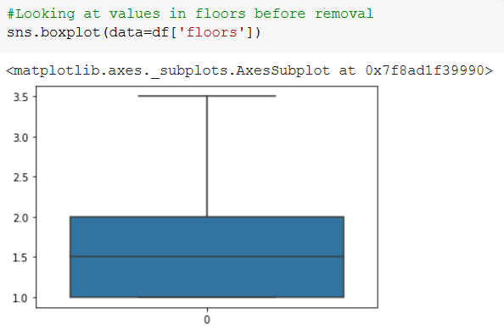
REGRESSION - PREPROCESSING

Slide 37


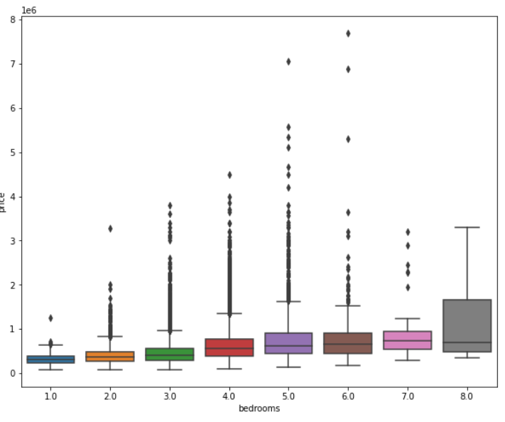
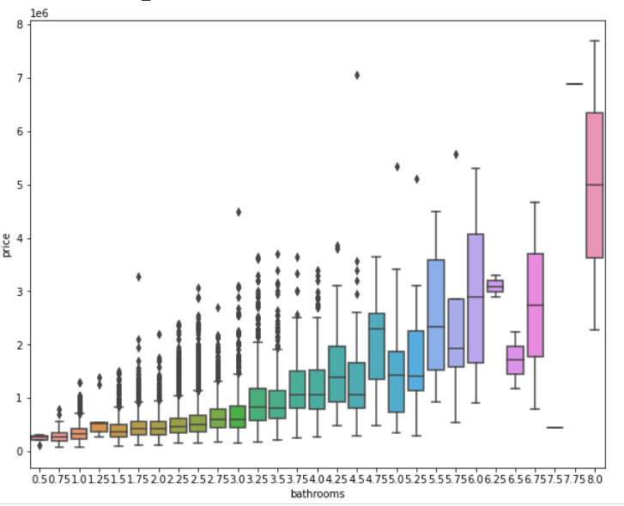
REGRESSION - RELATIONSHIPS

Slide 38


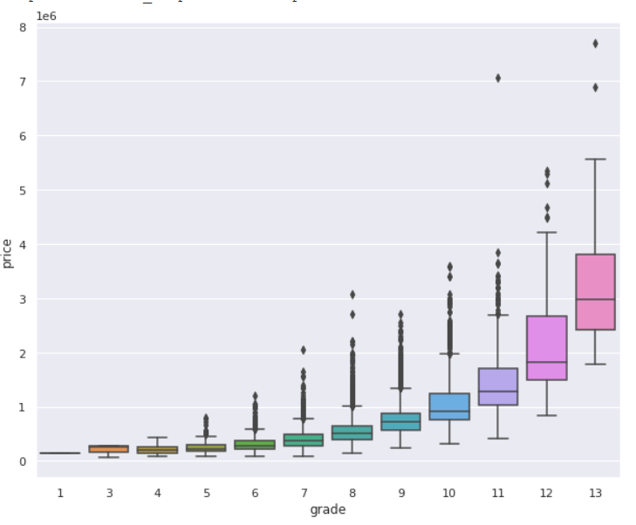

REGRESSION - PREPROCESSING

Slide 39




REGRESSION - PREPROCESSING

Slide 40





REGRESSION – DESKEWING & REMOVING OUTLIERS

Slide 41






REGRESSION – DESKEWING & REMOVING OUTLIERS

Slide 42




REGRESSION – DESKEWING & REMOVING OUTLIERS

Slide 43


REGRESSION – DESKEWING & REMOVING OUTLIERS

Slide 44


REGRESSION – DESKEWING & REMOVING OUTLIERS

Slide 45


REGRESSION – SCALING

Slide 46

REGRESSION – KNN

Slide 47

REGRESSION – KNN
Used best params from GridSearchCV, fit with scaled data & predicted

Slide 48



REGRESSION - KNN

Slide 49

REGRESSION - KNN

Slide 50

REGRESSION - DUMMY
Probably not going to be good

Slide 51

REGRESSION - DUMMY

Slide 52

REGRESSION – LINREG

Slide 53

REGRESSION – LINREG

Slide 54

REGRESSION – LASSO

Slide 55

REGRESSION – LASSO

Slide 56

REGRESSION – RIDGE

Slide 57

REGRESSION – RIDGE

Slide 58

REGRESSION – DECISION TREE

Slide 59

REGRESSION – DECISION TREE

Slide 60

REGRESSION – RANDOM FOREST

Slide 61

REGRESSION – RANDOM FOREST

Slide 62

REGRESSION – SUPPORT VECTOR

Slide 63

REGRESSION – SUPPORT VECTOR

Slide 64

REGRESSION – RESULTS
0.77317
0.74587
0.73727
0.73614
0.61562
Simpler baseline models to compare
0.61562
0.61274
-0

Slide 65


REGRESSION – RESULTS
Points generally fall on the blue line (y=x graph)
=> Predicted correctly
Plotting Actual price vs Predicted price

Slide 66

REGRESSION – RESULTS

Slide 67
THANK YOU!

